Slide 1
CS275 Project Proposal
Kexin Han & Qinjianhong Yang

Slide 2
Project Idea
A web application used for managing daily income and orders of a restaurant
Functions may include adding/deleting items, changing price, calculating daily income and calculating price of each order.
Implement useful buttons and tables to fulfill the user experience requirements so that the user can interact with the functions easily.

Slide 3
Functional Requirements
Be able to add or delete an item in the menu
Be able to alter the price of each item
Be able to group items based on their feature, such as dessert, drink, main dish or appetizer
Be able to calculate the total price of each order and save it to the database
Be able to trace daily income based on dates from the database

Slide 4
Scope of Development Effort
Create the frontend part of the project including component layout, adding basic information blocks and showing some test information
Work on the actions of the application. For example, click on button and trace back test data from database or click on a button and do calculations.
Create database skeleton for the project (should include several tables)
Create stored procedure for inserting, updating and deleting items in the table
Test and debug the application

Slide 5
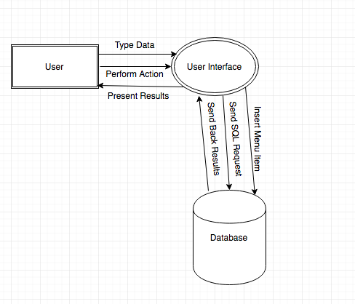
Information Flow Diagram

Slide 6
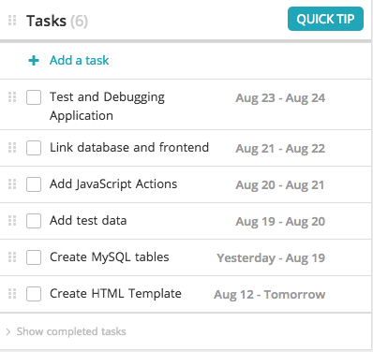
Work Plan and Schedule

